Slide 1

Starting the Snowball: Maximizing Project Success
Springboard Capstone Project #1
David Witten

Slide 2
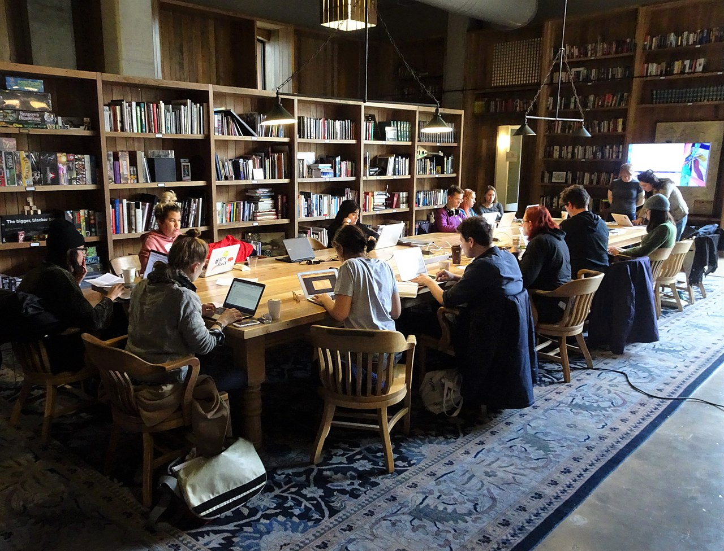
Kickstarter
Crowd funding website
Funding tends to be all or nothing
Kickstarter’s 20% threshold
Projects only receive funding if they meet their goal
How can projects grab the initial exposure?

Slide 3
Data
The data was originally scraped from Kickstarter
Over 400,000 rows
Data from April 2009 through April 2019
Notes:
https://www.kaggle.com/toshimelonhead/400000-kickstarter-projects

Slide 4
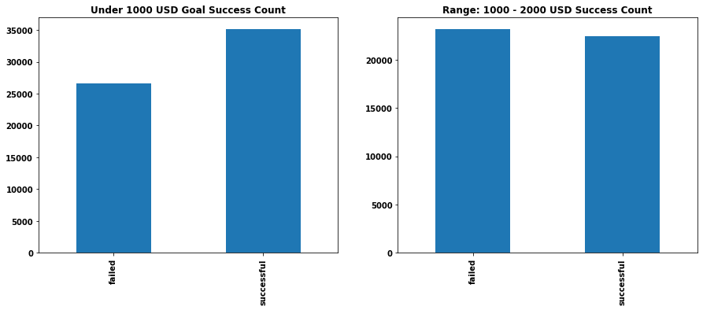
Cleaning: Serious Projects Only
The lowest goal for projects had by far the greatest chance of success

Slide 5
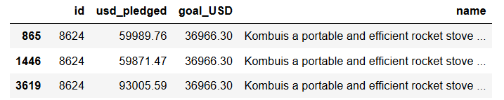
Data Cleaning: Duplicate Projects
The data was already cleaned
After removing the low goal projects there were 365,236 rows and 267,679 unique IDs
The same projects captured at different points in time

Slide 6
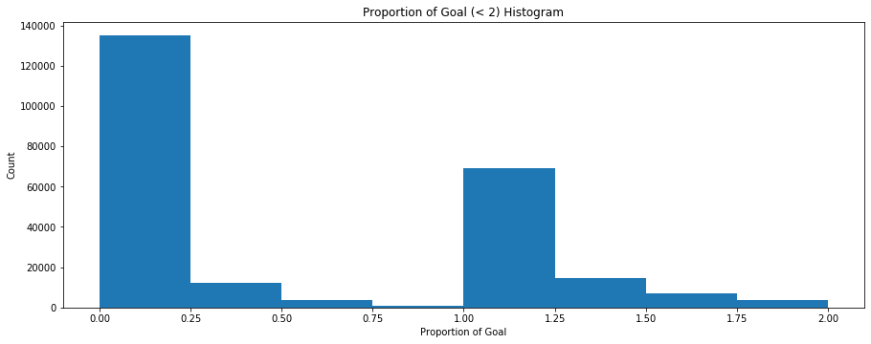
EDA: The Snowball

Slide 7
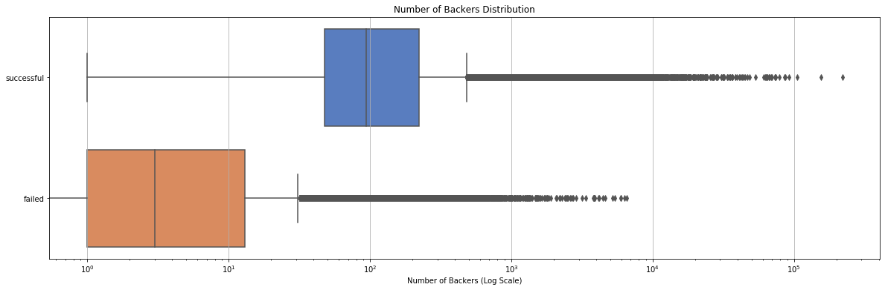
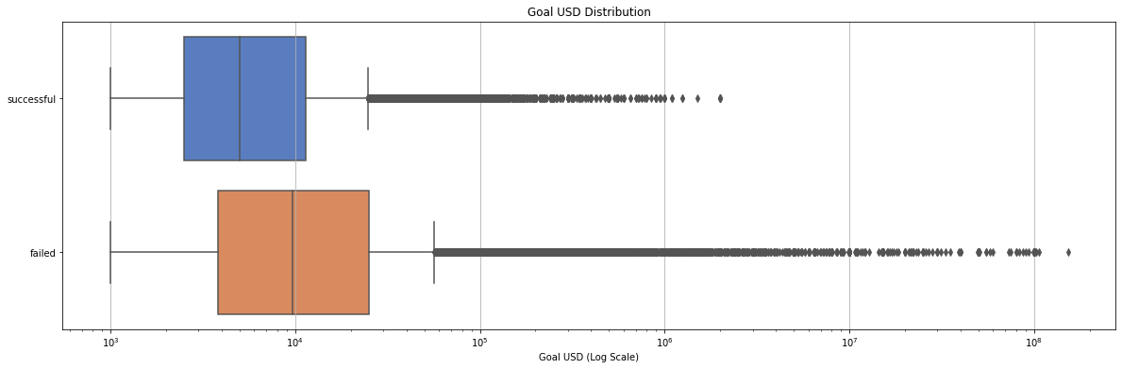
EDA: Number of Backers and Goal (USD)

Slide 8
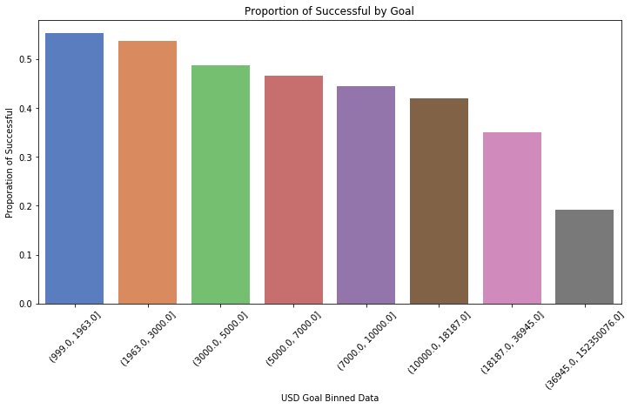
EDA: Success Rate by Goal

Slide 9
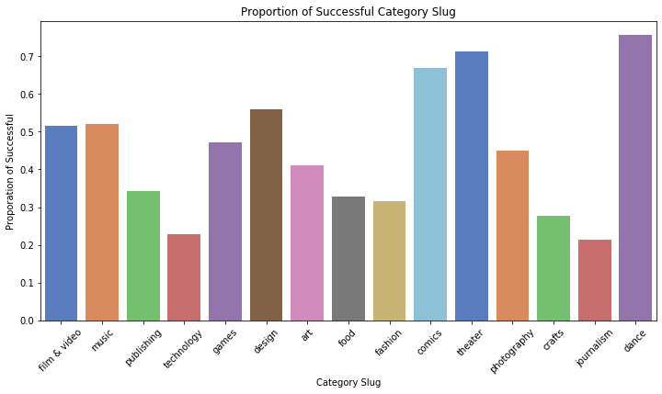
EDA: Categories

Slide 10
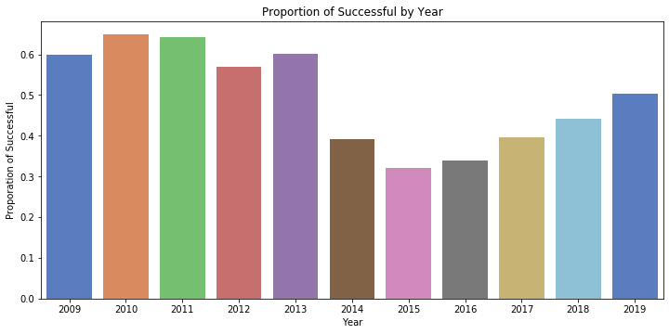
EDA: What Happened in 2014?

Slide 11
Machine Learning Models
Random Forest
Builds several “weak” decision trees to build strong final model
Light Gradient Boosting Machine
A forest based gradient boosting model

Slide 12
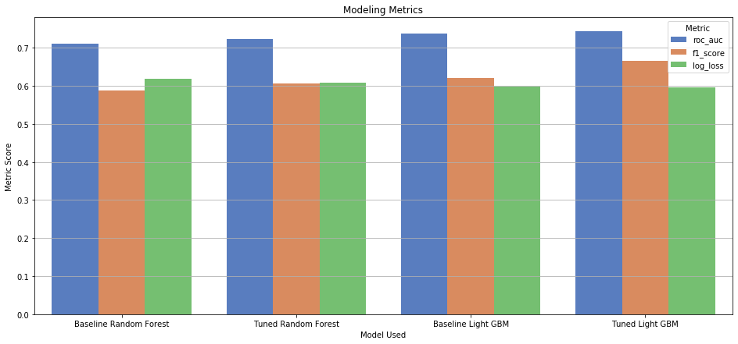
Model Comparison

Slide 13
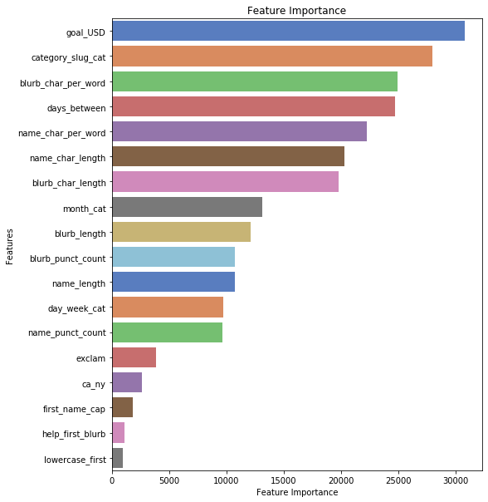
Tuned Light GBM Feature Importance

Slide 14
Conclusions
If you can find a way to start small, you have a better chance of snowballing and scaling up later
Kickstarter is conducive to some categories and punishing to others. Notably, it is especially punishing to publishing/journalism and technology projects
Putting effort into the name and blurb and keeping proper capitalization and punctuation can actually matter

